Slide 1
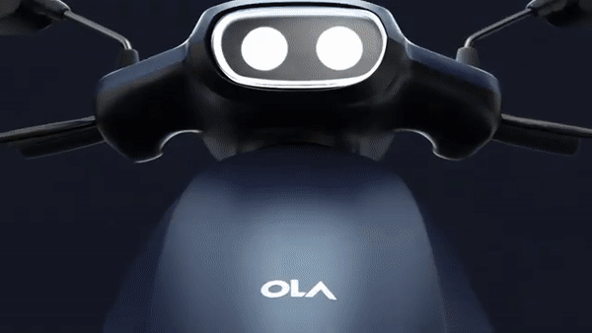

Business prospects in current Market Situation

Slide 2

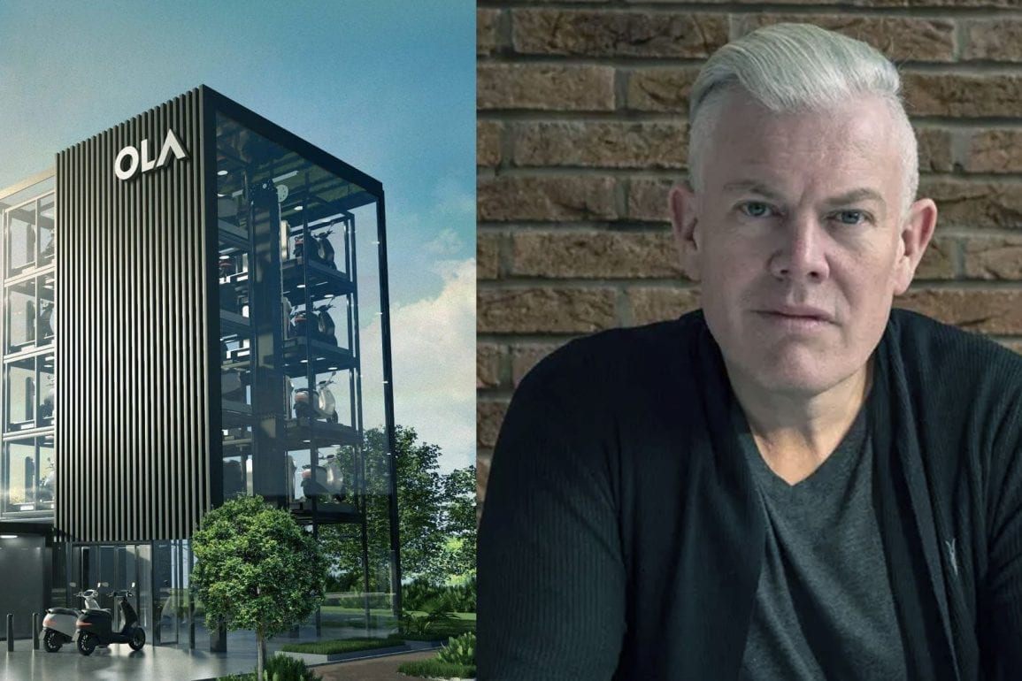


Team members
MUNAZZA BHOMBAL NISHA AGGRAWAL
[ PD15_194 ] [ PD15_064 ]
PIYUSH RAMGIRWAR SUCHITH MANMOHAN
[ PD15_017 ] [ PD15_214 ]

Slide 3
Company overview
Ola Electric is India’s leading manufacturer of electric vehicles (EVs). Ola Electric aims to move the world to sustainable mobility advanced electric vehicles manufactured at its Future factory, the largest, most advanced, and sustainable two-wheeler factory in the world.
Legal Name : Ola Electric Mobility Private Limited
Headquarters : Bangalore, Karnataka, India
Business Model : B2C
Founding Date : 26th May 2017
Founder : Bhavish Agrawal
Total Valuation : $ 5.04B

Slide 4
Parent Entity : ANI Technologies pvt ltd
Factory Location : Krishnagiri, Tamil Nadu
Factory Capacity : 10 M units per year (Largest in Asia)
Factory Area : 500 Acre
Employee Count : 3338
Annual Revenue : $ 15.1M
Total Funding : $ 866 M
Hub Tag : Unicorn

Slide 5










Investors and stakeholders

Slide 6


Investment done by ola electric:
Ola Electric has acquired Etergo on May 27, 2020.
Ola Electric has invested in Store Dot on May 24, 2022

Slide 7






KEY MARKET COMPETITOR

Slide 8
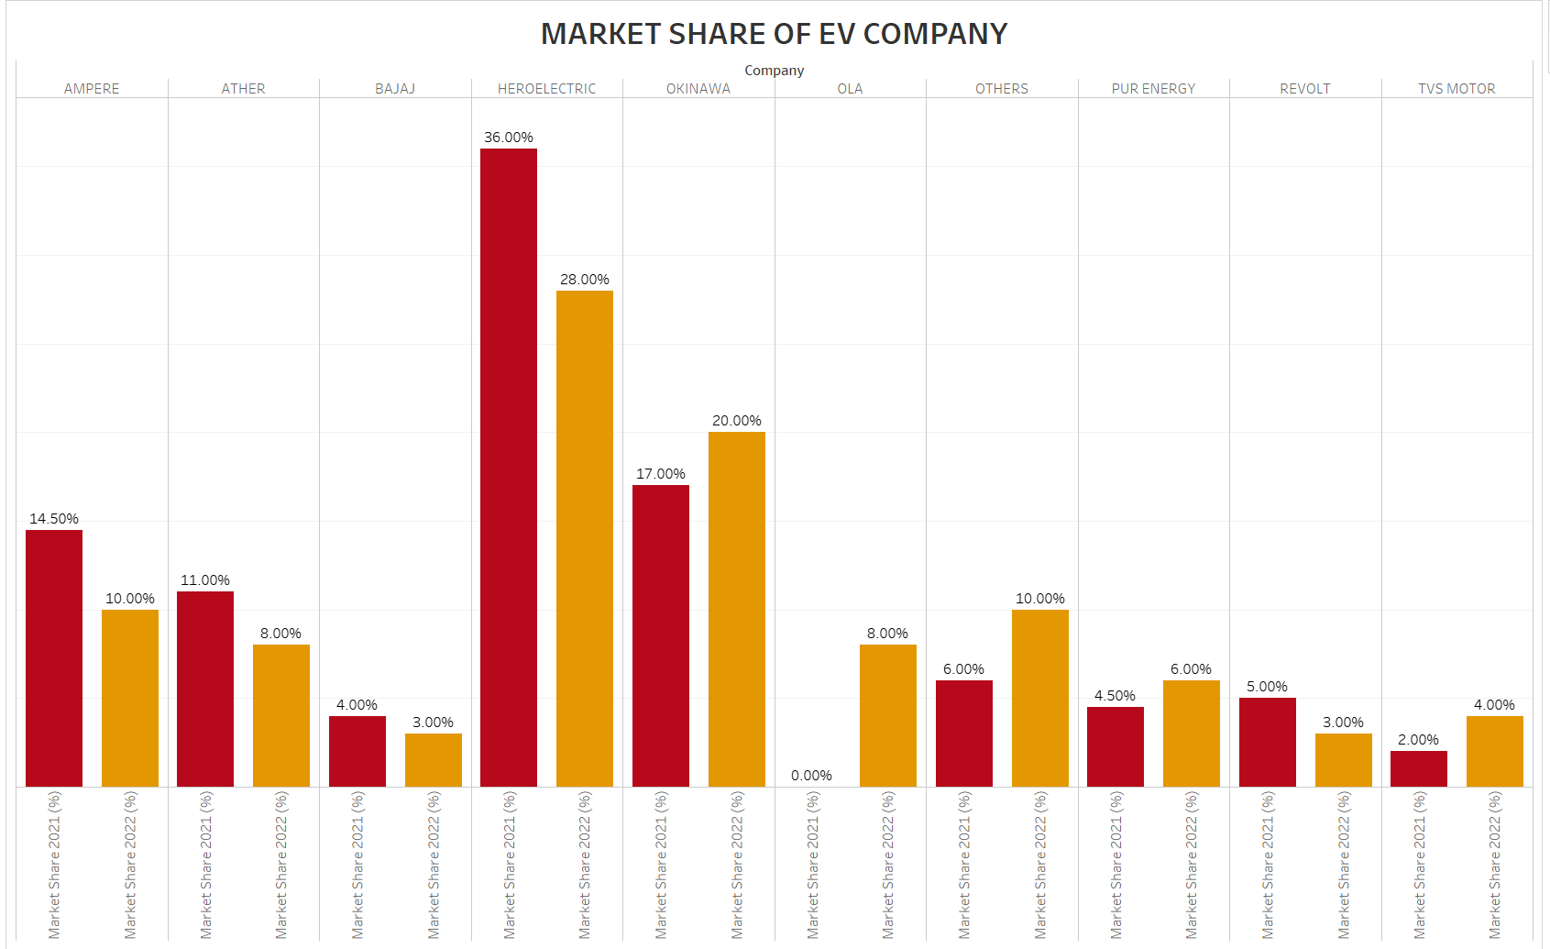

Slide 9
PR AND MEDIA
Ola does YouTube marketing, uses emotional appeal in Marketing, and does hashtag campaign
#JOINTHEREVOLUTION is the latest hashtag campaign for ola electric.
Ola, through its marketing strategies, highlights problems and offers the solution to customers. Customers relate to the problem and find the compelling solution that Ola offers.
SOCIOECONOMIC FACTORS
Decline in global oil during pandemic has created a significant shift to electric vehicles in the developing world
According to a survey, 62.93% of the users strongly agreed that electric vehicles are the future of transportation.
Saving on fuel expenses is the main reason people would but an electric scooter, it also requires less maintenance and it’s pollution free.

Slide 10
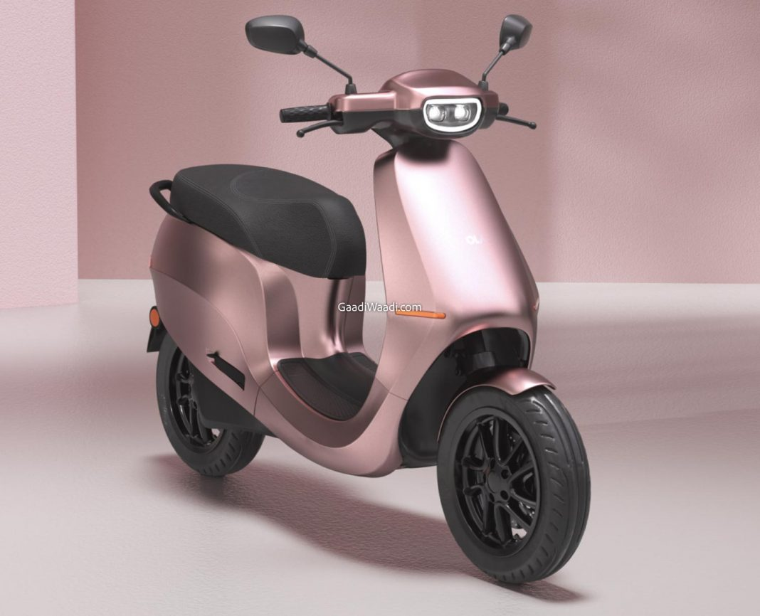
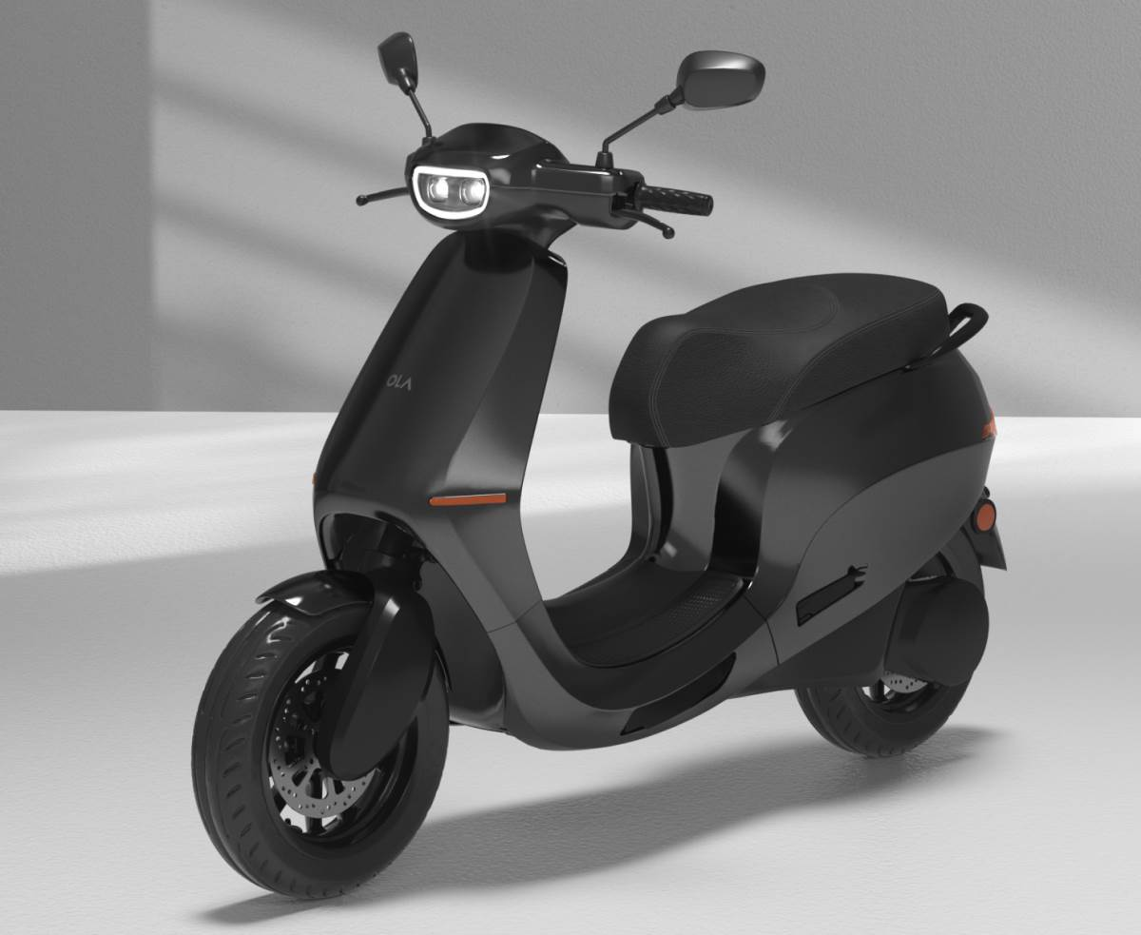
Ola electric products
S1 S1 PRO

Slide 11
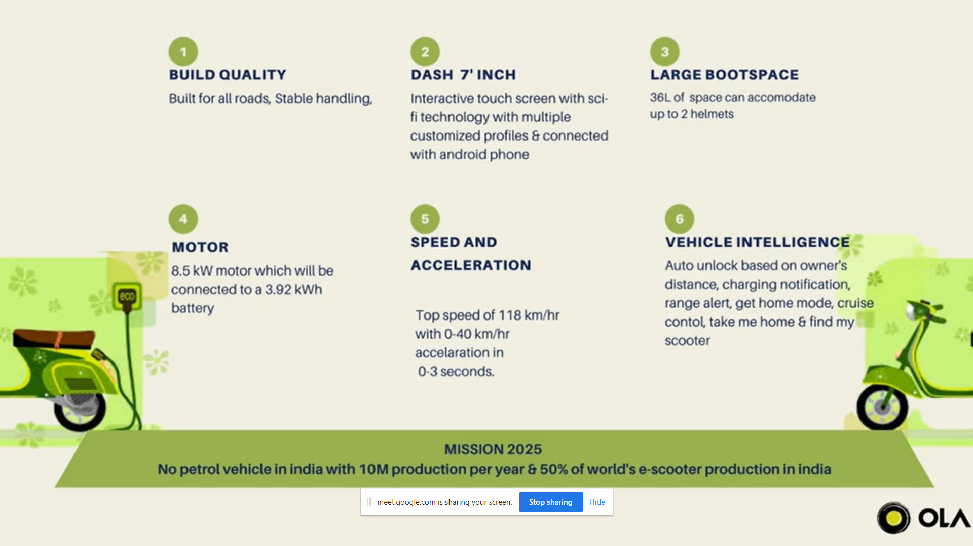

Slide 12
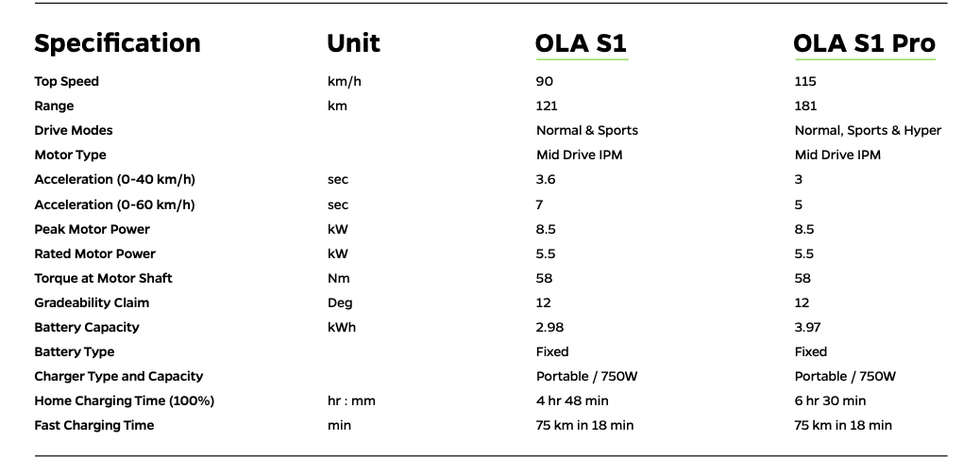
PRODUCT SPECIFICATIONS

Slide 13
S
W
0
T
Simple and minimalistic design.
Eco Friendly.
Manufacturing Plant which is most Sustainable, most Advanced and world’s Largest Plant.
Easy online booking for both Sales and Servicing.
The batteries, motors, vehicle computers and softwares are developed and manufactured in house.
Longest Range per charge.
Failed to deliver the vehicles in time as promised.
Multiple complaints of delivering damaged vehicles, battery overheating.
Lack of recharging infrastructure or no in house charging stations like the competitors.(Ather,TVS)
Absence of physical Showrooms to review the vehicle before booking and no service centers to attend in case of breakdown.
Subsidies provided by different state governments.
Lower taxes.
Food Delivery companies, Vehicle renting companies and Taxi Partners opting for electic vehicles than IC Vehicles.
Increasing fossil fuel costs.
Rectifying the mistakes and short comings of the product and rebuild the trust.
Increase in Electricity cost.
Entry of new companies and competition with rivals like Ather, Honda, TVS etc.
Competition or invention of alternate fuels, electric hybrids or hydrogen powered vehicles.

Slide 14
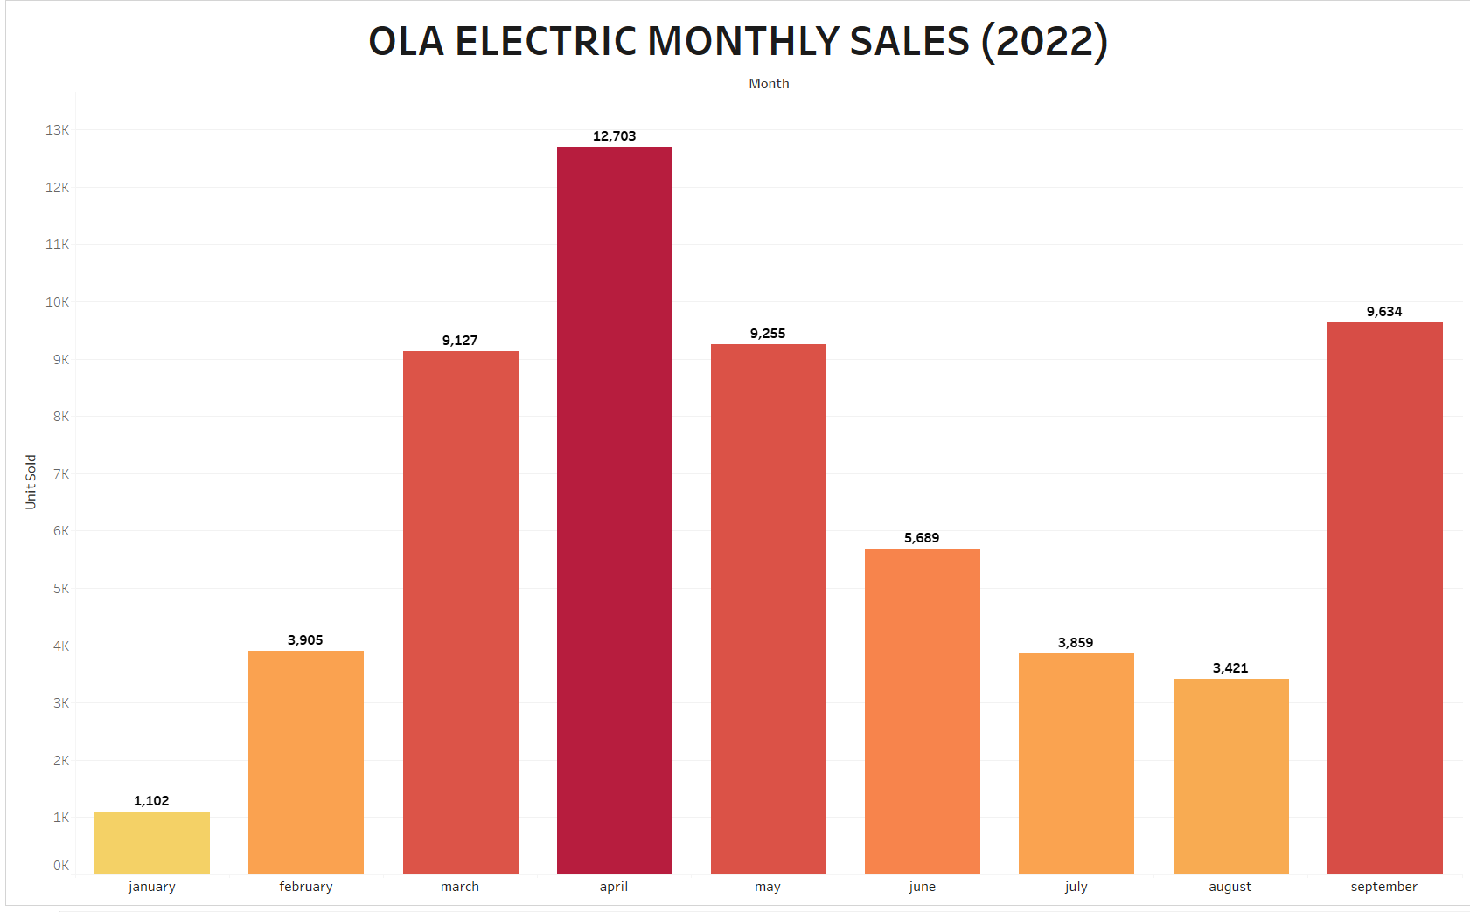
PRODUCT SALES

Slide 15
WHY OLA EV FAILED TO IMPRESS CONSUMERS
Yes, it does fail to impress its customers, it failed to set up a benchmark in the market, it failed to deliver what it promised, it failed in so many aspects but, none can deny the fact that Ola electric does bring the revolution in the Indian electric vehicle market. When it comes to the smart electric vehicle segment, previously we had only one company i.e., Ather 450x that too with decent performance, but the Ola electric scooter is great at both the performance and the features. When it comes to the problems with the electric scooter, we should understand that the Ola is making a revolution and a few issues may come with its beta version of vehicles.
MAJOR FAILURES :
TEMPERATURE ISSUE
MANUFACTERING DEFECTS
BATTERY FAILURES
BROKEN SCOOTERS
DELIVERY CANCELATION

Slide 16
Insights & solutions
Training Local Mechanics
As there is no local service provider and no spare parts available. Training and Certifying local mechanics as authorized OLA Mechanics with adequate spare parts for instant service.
Lacking Delivery Network
As there is no Local dealer, Tie up with a delivery partner to reach tier 2/3 cities and remote locations rapidly with existing delivery vendors.
OLA Experience Centers.
Setting up Display and Experience of products lead in having trust and idea for the buying customer.

Slide 17
BUSINESS DECISIONS/NEW STRATEGY
Ola electric is planning to Launch sub version of ola s1 which will be available at 80K.
Ola is giving 10K discounts on the Products
ALL THE PRODUCT OF COMPETITORS AVAILABLE IN THE PREMIUM EV MARKET
COMES IN THE RANGE FROM 1LAKH TO 1.5LAKH.
IT WILL CREATE A MAJOR BUZZ AND ACQUIRE MORE MARKET IF OLA
LAUNCHES THE PRODUCT IN 80K

Slide 18
Future strategy
Ola has promised more than 1lakh charging points in more than 400 cities in the next 5 Years.
Ola having the capacity to churn out 10 millions vehicles annually aims at initiating sales abroad in Europe and Asia Countries.
Ola electric being an Unicorn has ample amount of money and are going to invest of around 2400 crores

Slide 19
Entry to new market
BUSINESS LINE – ELECTRIC MOBILITY
LOCATION – BENGALURU
BUSINESS MODEL – B2C/D2C
COMPANY AGE – 5YEAR
PRODUCTS –
OLA ELECTRIC SEDAN
NEW MARKET ENTRY-
ELECTRIC 4 WHEELER
EXPECTED PRICE RANGE –
10 TO 25 LAKHS
EXPECTED DATE OF LAUNCH – DEC 2024
CATEGORY - SEDAN
KEY COMPETITORS
TATA MOTORS
MG
HYUNDAI
BYD
MAHINDRA
AUDI
MARKET SHARE
TATA MOTOR – 90%
MG -7%
OTHERS – 3%
TARGET MARKET – UPPER MIDDLE CLASS/HIGH CLASS
EXPECTED MARKET SHARE-
20%
COMPANY
PRODUCT
COMPETITORS
CUSTOMER

Slide 20
guestimates
Consider You travel 20 km per day For 365days = 7500 kms
(1) Petrol bike with 50 kmpl 7500 ÷ 50 = 150 litres for 1 year 150 * 100 (petrol price)
= 15,000 Rs + 2000 Service *** For 1 year petrol bile would cost = Rs. 17,000
(2) Electric scooter Ola s1 1 charge = 3kw = 100 kms 7500 % 100 kms = 75 full charge (consider as 100) 100 * 3 (battery capacity 3kwh) = 300 kw of charge 300 Kw * Rs 2 (TNEB price per kw) = 600 Assume use hyper charger 20 times in a year Hyper charger 1 kw = Rs 10 Using hype recharger 2 times per month = 10* 25 = 250 ** For 1 year Ola s1 cost = 850 = 1000 (round off) For 5 years Petrol bike 17,000 * 5 = 85,000 + 5000 = 90,000 Electric scooter 1,000 * 5
= 5,000 + 40,000 (battery) = 45,000
so, petrol vehicle costs you double

Slide 21


Slide 22
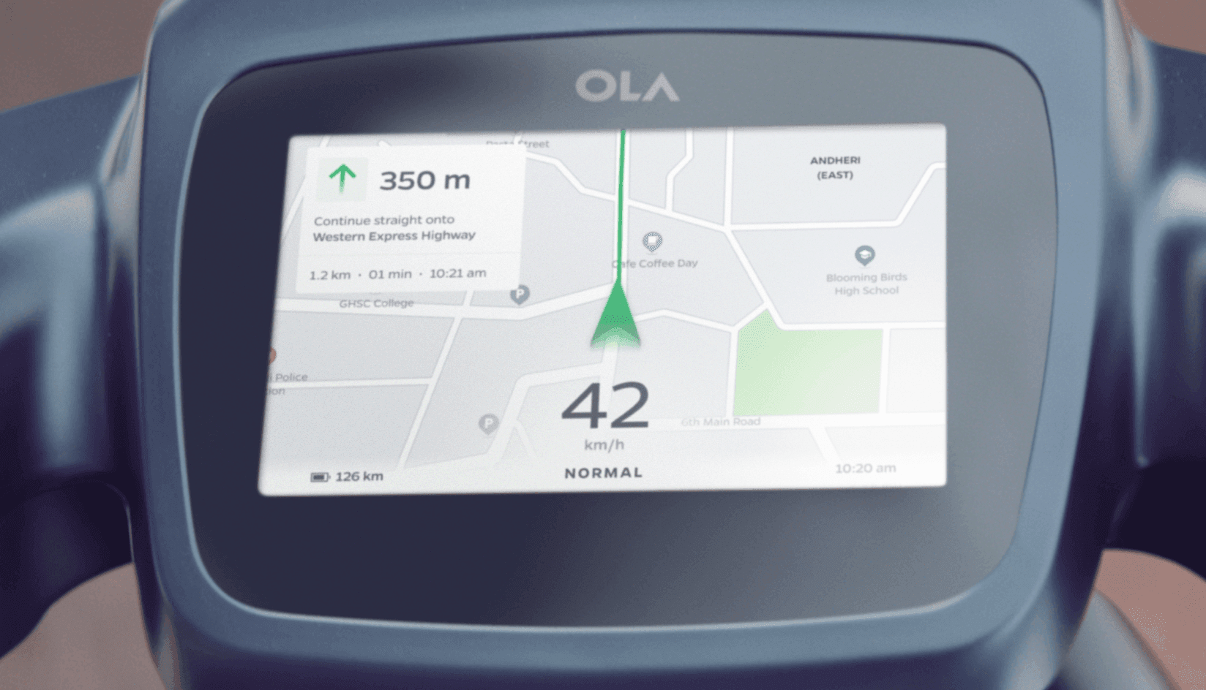
Thank you..!

